Slide 1


Integration Tests with Docker, Scala, Akka & ScalaTest
Andreas Gies
Lead Architect

Slide 2


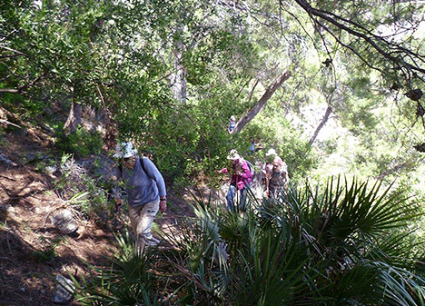
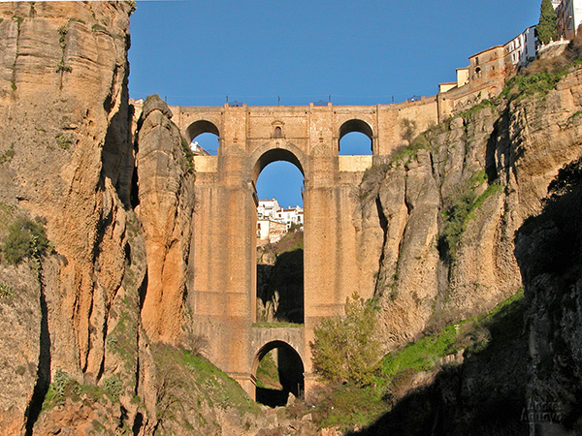
Technical Consulting
Conference speaking slots
Technical Trainings
Management Seminars
Team Breakouts
Coding by the sea
Yoga & learning
Team Building
Enjoy Andalucia
Notes:
Wander bild einfuegen

Slide 3
Project context
Java based, distributed retail application
Overall functionality as Messaging Backbone
Different container types in collaboration
~7 years in development, OSGi based
Migration to OSGi/Scala/Akka since 2011
Inherited with weak Specs and only manual Tests

Slide 4

Sample Test

Slide 5
A sample test scenario

Slide 6

Creating docker images

Slide 7

Docker in a nutshell

Slide 8
Layering Docker images

Slide 9
Docker container configuration
FROM atooni/blended-base:latest
ADD blended-karaf-demo-${project.version}-nojre.tar.gz /opt
RUN ln -s /opt/blended-karaf-demo-${project.version} /opt/blended
RUN mkdir -p /opt/blended/data
RUN chown -R blended.blended /opt/blended*
USER blended
ENV JAVA_HOME /opt/java
ENV PATH ${PATH}:${JAVA_HOME}/bin
ENTRYPOINT ["/opt/blended/bin/karaf"]
VOLUME /opt/blended/data
EXPOSE 1883
EXPOSE 8181
EXPOSE 1099
https://github.com/woq-blended/blended/blob/master/blended-docker/blended-docker-demo/src/main/docker/demo/Dockerfile

Slide 10
A container under test
Exposed Port
Exposed Port
Exposed Volume

Slide 11
Test packaging
Notes:
Sequenz kreieren

Slide 12
Defining the CuT
{
name: "gs4"
image: "^store_sibfile:latest"
links: [ "shop_0:shop" ]
ports: [
{ name: "http", value: "8181" }
]
volumes: [
{
host: "data"
container: "/opt/sibfile/data"
},
{
host: "tmp"
container: "/tmp"
}
]
}
{
name: "shop"
image: "^store_shop:latest"
links: [ "sonic_0:sonic" ]
volumes: [
{
host : "data"
container : "/opt/shop/data"
}
]
ports : [
{ name: "ftp", value: "4747" },
{ name: "http", value: "8777" },
{ name: "jms", value: "1883" }
]
},
{
name: "sonic"
image: "^store_sonic:latest"
ports : [
{ name: "data", value: "2620" },
{ name: "mgmt", value: "2608" }
]
},
https://github.com/woq-blended/blended/blob/master/blended-akka-itest/src/test/resources/application.conf

Slide 13

Integration test Elements

Slide 14
High Level Test Architecture
Notes:
Sequenz kreieren

Slide 15
General tasks to write tests
Define the containers under test
Start the CuT and wait until they are ready
Provide a blackbox test context
Execute the test suite

Slide 16
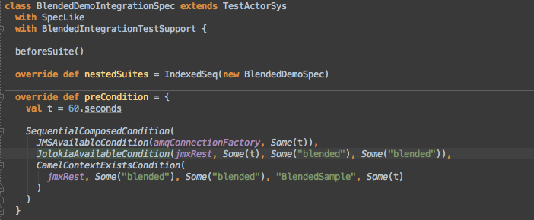
The enclosing Spec
https://github.com/woq-blended/blended/blob/master/blended-akka-itest/src/test/scala/de/woq/blended/akka/itest/BlendedDemoIntegrationSpec.scala#L44
Notes:
Link Picture to actual source code on github

Slide 17
CamelTestSupport
Create & send test messages
Wire mock Endpoints
Frequently used message assertions
https://github.com/woq-blended/blended/blob/master/blended-itestsupport/src/main/scala/de/woq/blended/itestsupport/camel/CamelTestSupport.scala

Slide 18
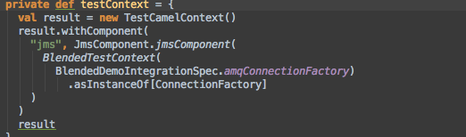
The example test context
Provide a Camel based test context with all required components for testing
https://github.com/woq-blended/blended/blob/master/blended-akka-itest/src/test/scala/de/woq/blended/akka/itest/BlendedDemoSpec.scala#L42

Slide 19
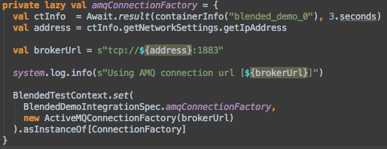
Providing the JMS connection
We know the JMS port is 1883 and Active MQ is the JMS provider
Keep information relevant across Specs in an instance of BlendedTestContext
https://github.com/woq-blended/blended/blob/master/blended-akka-itest/src/test/scala/de/woq/blended/akka/itest/BlendedDemoIntegrationSpec.scala#L66

Slide 20
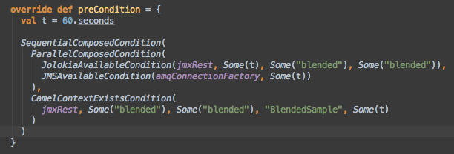
Waiting for the container
Wait until Jolokia, JMS and the Camel Route under test are available
https://github.com/woq-blended/blended/blob/master/blended-akka-itest/src/test/scala/de/woq/blended/akka/itest/BlendedDemoIntegrationSpec.scala#L47

Slide 21
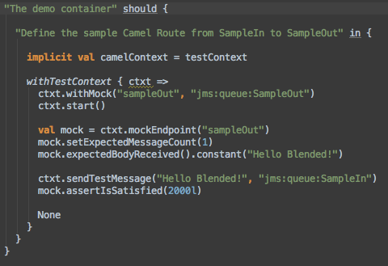
Finally, the spec
https://github.com/woq-blended/blended/blob/master/blended-akka-itest/src/test/scala/de/woq/blended/akka/itest/BlendedDemoSpec.scala#L54
Notes:
Link Picture to actual source code on github

Slide 22
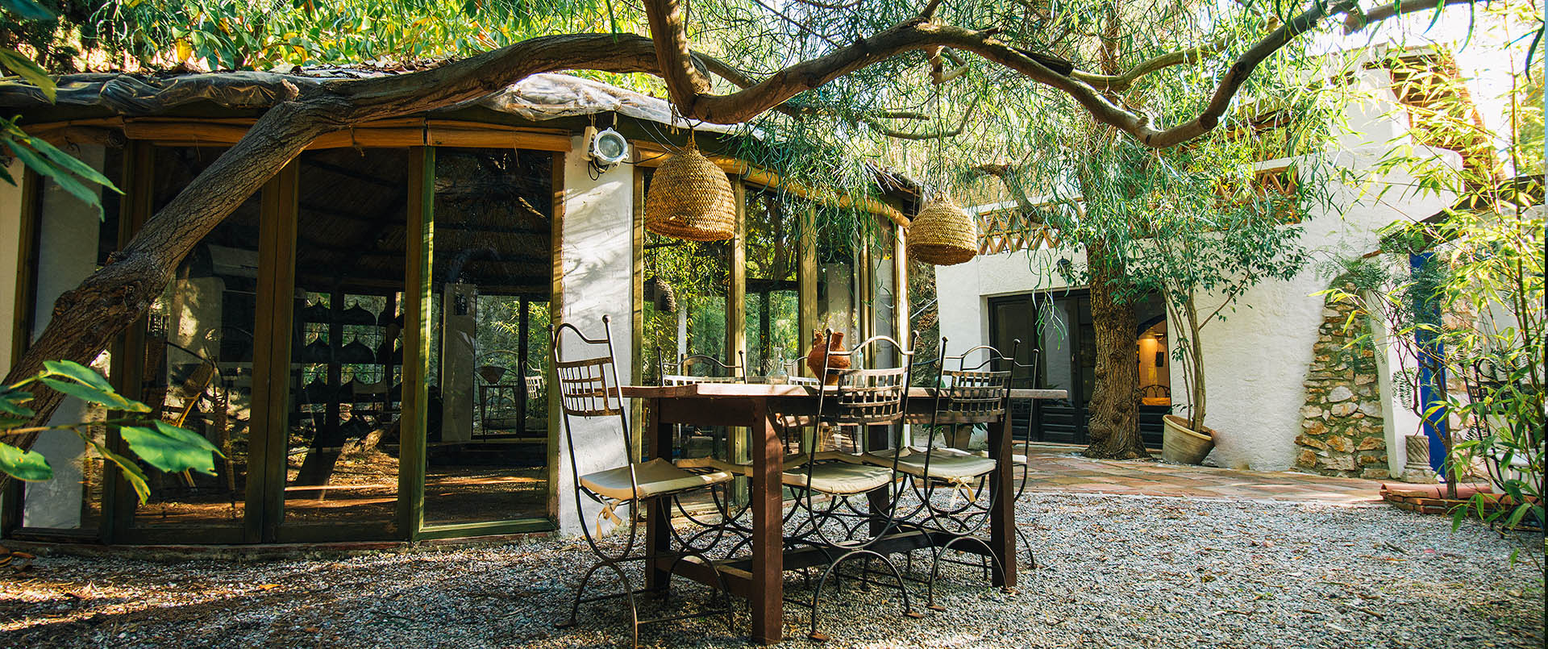
Main Test Framework elements

Slide 23
An Akka based Container Mgr
https://github.com/woq-blended/blended/blob/master/blended-itestsupport/src/main/scala/de/woq/blended/itestsupport/docker/ContainerManager.scala
Notes:
Sequenz kreieren

Slide 24
Container Actor
https://github.com/woq-blended/blended/blob/master/blended-itestsupport/src/main/scala/de/woq/blended/itestsupport/docker/ContainerActor.scala#L17
Notes:
Sequenz kreieren

Slide 25
Managing Conditions
https://github.com/woq-blended/blended/blob/master/blended-itestsupport/src/main/scala/de/woq/blended/itestsupport/condition/ConditionActor.scala#L30
Notes:
Sequenz kreieren

Slide 26
Composed Conditions
https://github.com/woq-blended/blended/blob/master/blended-itestsupport/src/main/scala/de/woq/blended/itestsupport/condition/ParallelConditionActor.scala
https://github.com/woq-blended/blended/blob/master/blended-itestsupport/src/main/scala/de/woq/blended/itestsupport/condition/SequentialConditionActor.scala
Notes:
Sequenz kreieren

Slide 27
More test support
Akka based JMS producer/consumer for throughput measurements (Early stage)
Akka based Jolokia client to Query the container’s JMX resources via REST
https://github.com/woq-blended/blended/blob/master/blended-itestsupport/src/main/scala/de/woq/blended/itestsupport/camel/CamelTestSupport.scala

Slide 28
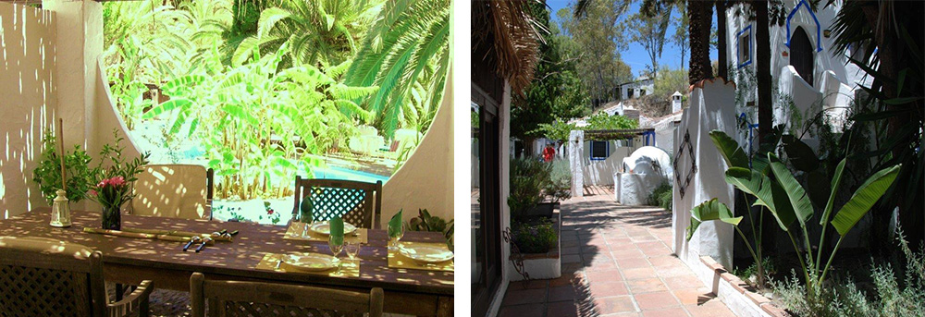
Online Example

Slide 29
Example sources / build
Container packaging
Docker definition
Integration test framework
Jolokia support
Example Test
Jenkins build of Example Test

Slide 30
Integration test guidelines

Slide 31
Integration Test Guidelines
Concentrate on Blackbox Tests
Or Don’t modify the CuT to test it …
Identify the Communication endpoints
Aim for readable Specs and discuss with end users
Specify Green and Red Path Tests
Try to capture load scenarios
Hard to define due to machine dependencies
Test fixtures
Try to abstract test fixtures into abstract classes

Slide 32

Conclusion

Slide 33
More to come…
Working
Wishlist / Issues
Container Management
Test Framework with easy hooks to CuT
Implicit Test Context for Blackbox testing
Syntactic sugar and support for Camel based black-box testing
More syntactic sugar for Conditions
Kill Containers throughout test for failover testing
Leverage a hosting env. like Openshift to execute Containers under test
Publish Test Framework as independent project

Slide 34
Resources
GitHub Project Blended
Travis Build – Waffle Board – Codacy Code metrics - Project Page
Way of Quality Homepage
Scala – Akka – Docker – ScalaTest
Apache Camel - for writing test routes
Apache Karaf - The containers under test in the samples
Apache ActiveMQ - The JMS layer used in the samples
Hawtio – The management console of the test containers
Jolokia – A JMX to REST bridge

Slide 35

Stay in contact !
andreas@wayofquality.de
http://de.linkedin.com/pub/andreas-gies/0/594/aa5
https://www.facebook.com/andreas.gies.5
@andreasgies, #WOQ-Blended on Twitter
Enjoy a course or a Yoga & coding breakout by the sea
http://www.castillosanrafael.com

